Slide 1


Type Master
TypeType Master is a console-based typing tutor application designed to enhance typing speed and accuracy through interactive exercises and real-time feedback.

Slide 2


Enhancing Typing Skills with TypeGenius
1
Overview
In the digital age, efficient typing is vital for productivity.
2
Interactive Learning
Offers drills for words and sentences with visual feedback.
3
Performance Metrics
Users can monitor speed and accuracy to identify patterns.

Slide 3

Project Objectives
Typing Enhancement
Progress Tracking
The application aims to boost typing speed (WPM) and accuracy through tailored practice sessions.
Comprehensive statistics and session history allow users to track their typing improvement over time, providing motivation and clarity.
1
2
3
Diverse Practice Modes
Users can select between different modes such as word drills and timed sentence challenges, catering to varied learning preferences.

Slide 4
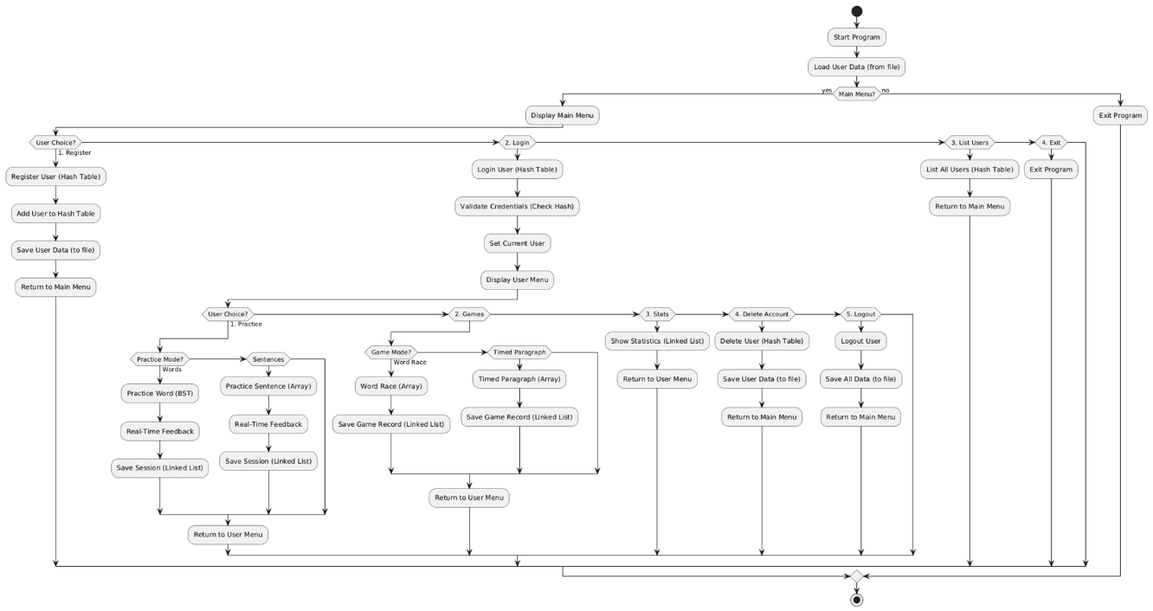
FLOWCHART
Notes:
FLOWCHART

Slide 5
Data Structures Used
1
Hash Table for Users
2
Linked Lists for Sessions
Optimizes user authentication by fast lookup (O(1)), uses linked lists for collision management.
Stores user typing history and game records with dynamic size and efficient insertion (O(1) at head).
3
Binary Search Tree
4
Arrays
Organizes practice words efficiently with O(log n) search time for personalized content.
2D array for keyboard layout and arrays for practice content like sentences and key states.

Slide 6



Design Concept
Modular Structure
1
The app features a clear separation of functionalities for better maintainability.
Visual Feedback
2
Color-coded keyboard feedback enhances the interactive experience with instant error alerts.
Persistence
3
User data is saved to a file, ensuring progress is retained across sessions.

Slide 7




Team Responsibilities Overview
Harsh Aggrwal (Team Leader)
Anubhav
1
2
Game modes and user data structures, implementing various game functionalities.
Data structures and utility functions including hash table and memory management.
Ronit
Dipanshu
4
3
Practice modes and statistics, enhancing user experience with performance tracking.
Overall project coordination with focus on application flow and error handling.

